Slide 1

The Managerial Economics and Business Environment
Guru Srinivasan

Slide 2
Lesson Content
Micro and macro economics
Fundamentals of Demand and Supply
Business Cycle
Circular Flow of income
Key macroeconomic variables
Unemployment

Slide 3
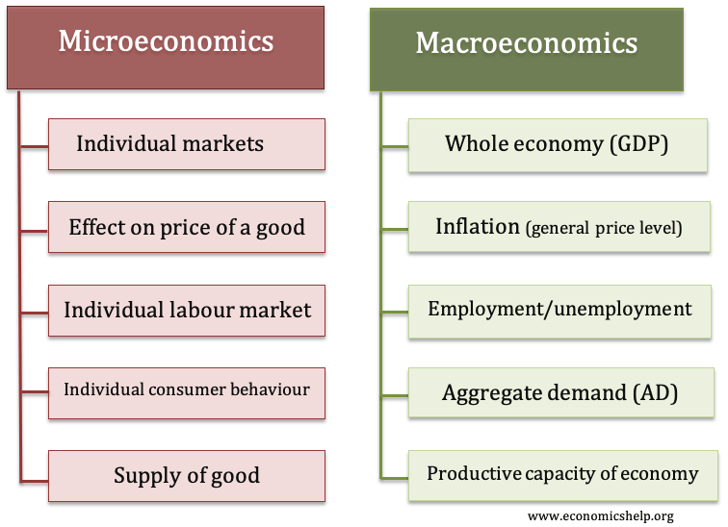
microeconomics and macroeconomics

Slide 4
Why Managerial Economics?
It integrates economic theories with business practices
Help decision making and management planning
Includes Demand Analysis and Forecasting, Pricing decisions, capital management, and improves market knowledge

Slide 5
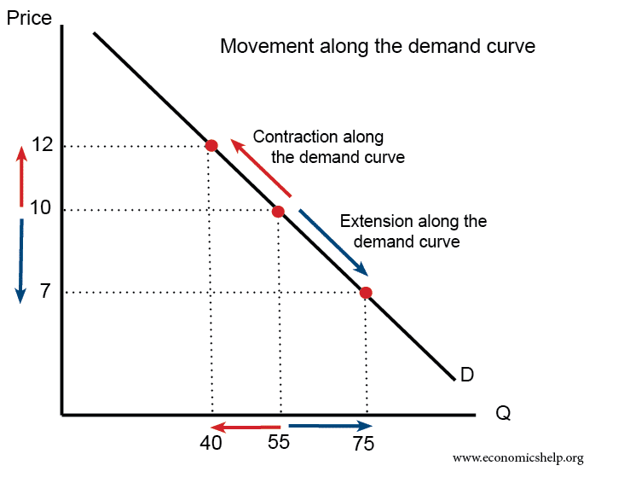
Demand
Demand is desire to own, with ability to pay and willingness to pay during a specific period.
LAW OF DEMAND states that with other factors being constant, Price and Quantity of any good and service in inversely proportional
Demand Curve shows relationship between price of a good and quantity demanded with all other variables constant
A contraction on the demand curve is due to higher price leading to lower demand
An extension on the demand curve is due to lower price leading to higher demand.

Slide 6
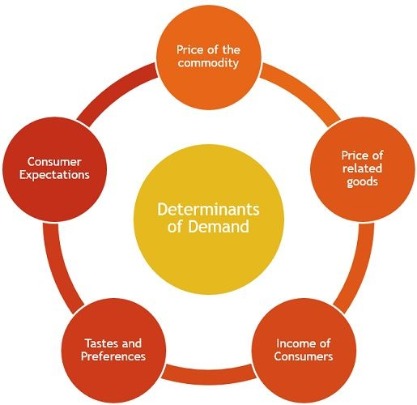
Determinants of Demand
Price of the commodity: Demand and price, hold an inverse relationship, hence, the price of the commodity shoots up, when the quantity demanded experiences a drop.
Price of related goods: Related goods can be of two types:
Complementary goods: Goods which are consumed together are called complementary goods, such as shoes and socks, wire and plug. A rise in the price of one will result in the demand of the other to fall.
Competing goods or substitutes: Goods which are consumed to satisfy the same want are counted as substitutes for one another, such as soap and body wash, shoes and slipper, etc. In the case of substitute products, a rise in the prices of a product leads to the rise in demand for its substitutes.
Income of Consumers: The purchasing power of a consumer depends primarily on his income. Therefore, the higher the income of the consumer, the higher will be the quantity demanded.
Tastes and Preferences: Consumer tastes and preferences change over time and normally trending items often fetch high demand, as compared to the outdated one.
Consumer Expectations: When there is an expectation of rise or fall in prices or any sudden change in the economy, it affects the current demand for the product.
Notes:
Price of the commodity: We know that demand and price, hold an inverse relationship, so whenever, the price of the commodity shoots up, the quantity demanded experiences a drop.
Price of related goods: Related goods can be of two types:
Complementary goods: Goods which are consumed together are called complementary goods, such as shoes and socks, wire and plug, ink pad and stamp. A rise in the price of one will result in the demand of the other to fall.
Competing goods or substitutes: Goods which are consumed to satisfy the same want are counted as substitutes for one another, such as bulb and tube light, soap and body wash, shoes and slipper, etc. In the case of substitute products, a rise in the prices of a product leads to the rise in demand for its substitutes.
Income of Consumers: The purchasing power of a consumer depends primarily on his income. Therefore, the higher the income of the consumer, the higher will be the quantity demanded.
Tastes and Preferences: Consumer tastes and preferences change over time and it has been observed that trending items often fetch high demand, as compared to the outdated one. For example: During the lockdown period, a rise in the demand for laptops has been recorded, because work from home is given by many companies.
Consumer Expectations: When there is an expectation of rise or fall in prices or any sudden change in the economy, it affects the current demand for the product. For instance: You might have noticed that the demand for the groceries and essential items increased prior to the lockdown became effective countrywide.

Slide 7
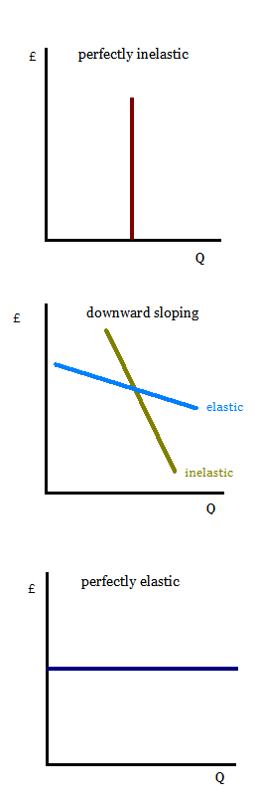
Price elasticity of Demand
It is a measure of relationship between changes in the quantity demanded and change in its price
Frequently used economics term to discuss price sensitivity
Elasticity measures the relationship based on consumer demand, consumer income and available supply
Elastic demand is when a product or service's demanded quantity changes by a greater percentage than changes in price. The opposite of elastic demand is inelastic demand, which is when consumers buy largely the same quantity regardless of price*.
Determinants of Price Elasticity of demand include
If the good is a necessity or luxury – necessities have inelastic demand whereas luxury have more elastic demand
Proportion to Consumer income – products that take higher percentage of income will have ore elastic demand
* NOTE:
Price elastic of demand greater than 1, demand is elastic: consumer purchases respond a lot to a price change
equal to 1, demand is unit elastic
less than 1, demand is inelastic: consumers do not respond much to a change in price

Slide 8
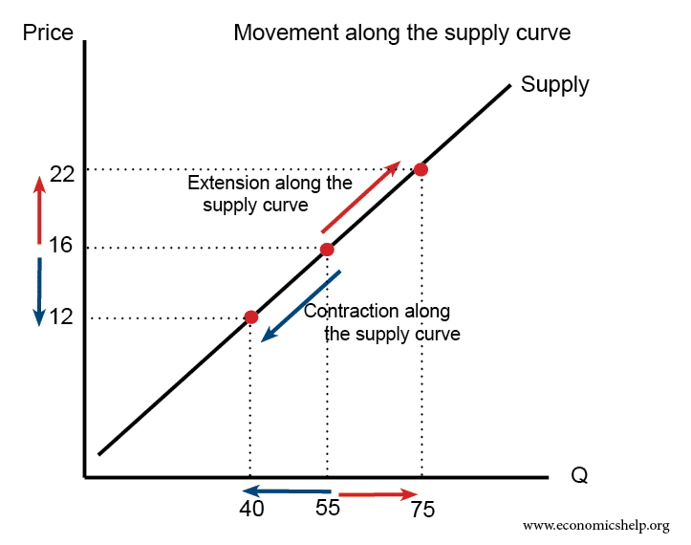
Supply
Quantity of output bought from the market at certain price
It is measure of amount of good that producer would want to produce and sell at specific price
Supply Curve shows relationship between price of a good and quantity demanded with all other variables constant
A higher price causes an extension along the supply curve (more is supplied)
A lower price causes a contraction along the supply curve (less is supplied)

Slide 9

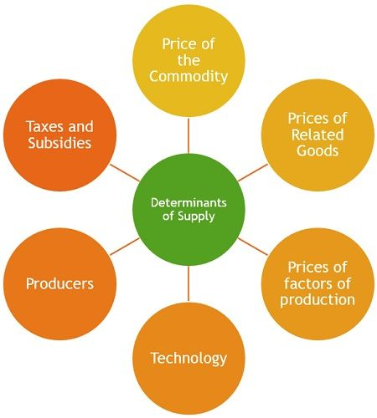
Determinants of Supply
Price of the Commodity: The higher the price of the commodity, the higher will be its quantity supplied. This is due to the fact that the firm produces goods and services with an aim of earning profits and when the price increases, the profit margin of the firm also tends to rise.
Prices of Related Goods: When there is a hike in prices of the related goods, then obviously, it is a profitable option for the firm to produce and sell the related goods, then the good in question, and this will lead to the fall in in the quantity supplied of that commodity.
Prices of factors of production: The cost of production depends on the factors of production, which influences the supply of the product. A hike in the price of input will automatically increase the cost of production and affects its profitability.
Technology: New and improved methods are developed, which are better in terms of productivity and quality of the goods while using the same amount of resources. This results in the increase in quantity supplied of some products, while decreasing the quantity supplied of another which are displaced.
Producers: If there are many firms in the market producing the same product, then obviously the supply will be more.
Taxes and Subsidies: Government imposes taxes on the production of goods and a rise in the rate of taxes will lead to a rise in the cost of production. Therefore, only when there is a rise in its prices, the quantity supplied will be increased. Contrary to this, Government subsidies, often bring down the cost of production, so the firms can easily increase supply.
Notes:
Price of the Commodity: The higher the price of the commodity, the higher will be its quantity supplied. This is due to the fact that the firm produces goods and services with an aim of earning profits and when the price increases, the profit margin of the firm also tends to rise.
Prices of Related Goods: When there is a hike in prices of the related goods, then obviously, it is a profitable option for the firm to produce and sell the related goods, then the good in question, and this will lead to the fall in in the quantity supplied of that commodity. For example: If there is a rise in the price of pulses, the farmers will use their resources to grow pulses, rather than other cereals, as it is a more profitable option to them.
Prices of factors of production: The cost of production depends on the factors of production, which influences the supply of the product. A hike in the price of input will automatically increase the cost of production and affects its profitability. For example: Suppose the prices of petrol shoot up, which leads to an increase in the cost of production as well as transportation of the goods.
Technology: Technology has a great impact on production, as new and improved methods are developed, which are better in terms of productivity and quality of the goods while using the same amount of resources. So, this results in the increase in quantity supplied of some products, while decreasing the quantity supplied of another which are displaced.
Producers: If there are many firms in the market producing the same product, then obviously the supply will be more.
Taxes and Subsidies: Government imposes taxes on the production of goods and a rise in the rate of taxes will lead to a rise in the cost of production. Therefore, only when there is a rise in its prices, the quantity supplied will be increased. Contrary to this, Government subsidies, often bring down the cost of production, so the firms can easily increase supply.

Slide 10

Price Elasticity of Supply
Measures relationship between change in quantity and change in price
Main factors that determine degree of price elasticity of supply are
Time period
Ability to store output – how long goods can be stored without compromising quality
Factor mobility - ability to move factors of production — labour, capital, or land —out of one production process into another.

Slide 11
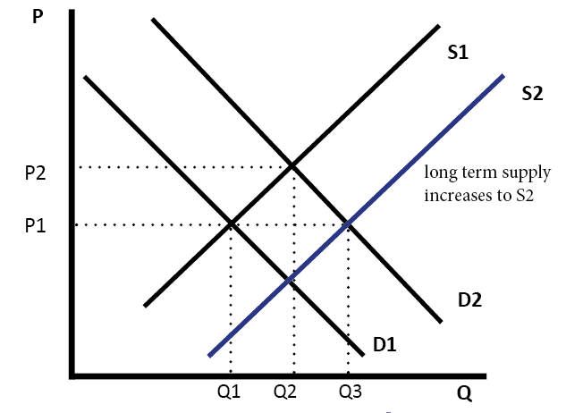

Relationship between Demand and Supply

Slide 12

Pricing Decision
Pricing is important area in managerial economics
Pricing decisions based on
market forms,
differential pricing,
product-line pricing

Slide 13

Questions

Slide 14
Types of Market Structure
Market Structure
Perfect Competition
Monopoly
Oligopoly
Monopolistic Competition
Perfect competition
Large number of buyers and sellers
No one buyer or seller have significant influence
All firms aim to maximise profits
Free entry and exit
Monopolistic competition
Large number of buyers and sellers
Consumers have some preferences in choice
Sellers can become price setters
Oligopoly
Few dominant firms
Sometimes these firms collaborate together
There are some barriers to entry
Monopoly
One firm control the market
The firms are price setters
Consumers do not have choices

Slide 15
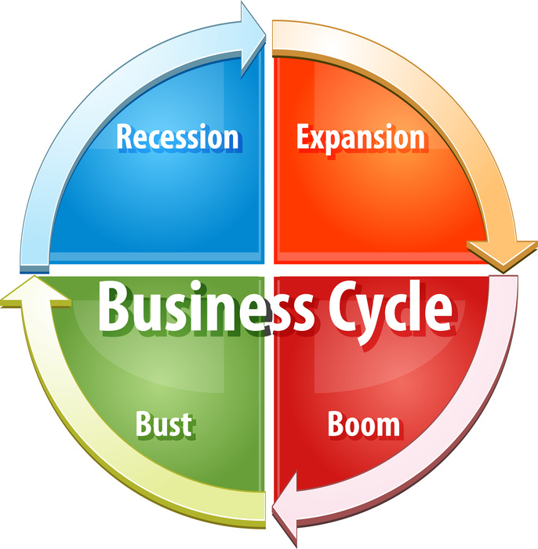
Economics and Business Cycle
Recovery – Economic activity increase, but general price also increases
Prosperity – Rapid movement in price employment, income and production. Peak prosperity may lead to over-optimism
Recession – When the business cycle take downward turn and may lead to depression, unemployment and decline on stock market value
Depression – General demand falls faster than production

Slide 16
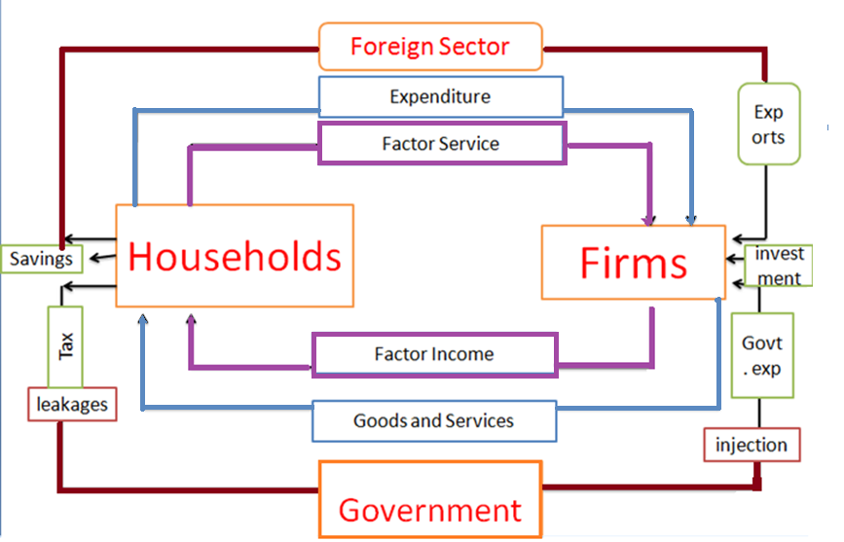
Circular Flow of income
Production Phase - concerns income generation
Income phase – movement of factors of production like wages, rent, interests from firms to household
Expenditure phase – income generated through factors of production spent mostly on goods and services produced by firm

Slide 17
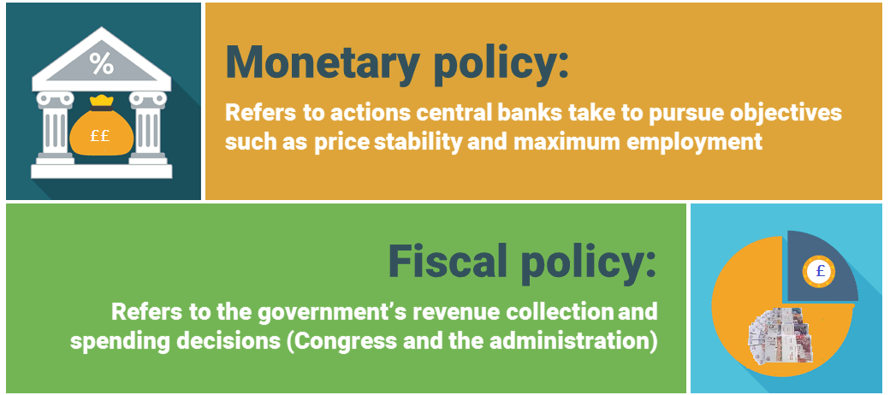

Central bank and Government
Monetary policy is used to control the money supply and interest rates.
Fiscal policy uses the government’s power to spend and tax.
How moving away from Gold standard influenced Fiat money?

Slide 18

Key Macroeconomic Variables
Economic growth – the positive economic growth will improve productivity for the business sin the same was productivity can contribute to economic growth. The economic growth also increases consumer spending and benefits business.
Interest rates - The interest rates determine the cost of borrowing as well as consumer preference to spend or save. When the interest rates are higher, the consumers may choose to save, and lower interest rates simulates spending. Similarly, the lower interest rate also reduces cost of borrowing for business to encourage expansion.
Unemployment - When the unemployment rate is low, fewer of the new jobs added are worth the cost of paying the employees. And thus, every job added after that is inefficient. This is often called slack in the labour market
Inflation - Rising prices, known as inflation, impact the cost of living, the cost of doing business, borrowing money, mortgages, corporate, and government bond yields, and every other facet of the economy exchange rates. High rates of inflation mean that unless income increases at the same rate, people are worse off. This leads to lower levels of consumer spending and a fall in sales for businesses.
Exchange Rate - An exchange rate is the value of a country's currency vs. that of another country or economic zone. Most exchange rates are free-floating and will rise or fall based on supply and demand in the market. When exchange rates change, the prices of imported goods will change in value, including domestic products that rely on imported parts and raw materials. Exchange rates also impact investment performance, interest rates and inflation - and can even extend to influence the job market and real estate sector.
Gross Domestic Produce - Total monetary or market value of all the finished goods and services produced within a country's borders in a specific time period. Nominal GDP is the market value of goods and services produced in an economy, unadjusted for inflation. Real GDP is nominal GDP, adjusted for inflation to reflect changes in real output.

Slide 19
Main Drivers of Inflation
Inflation
Demand Pull - based on inflation as the result of excess demand.
Cost-Push - When the cost of production increases, the price can be pushed up instead of increase in demand
Mixed Demand Inflation - When the reasons for price increase is as the result of combinations of any of the factors such as increase in demand or lower supply or increasing costs

Slide 20
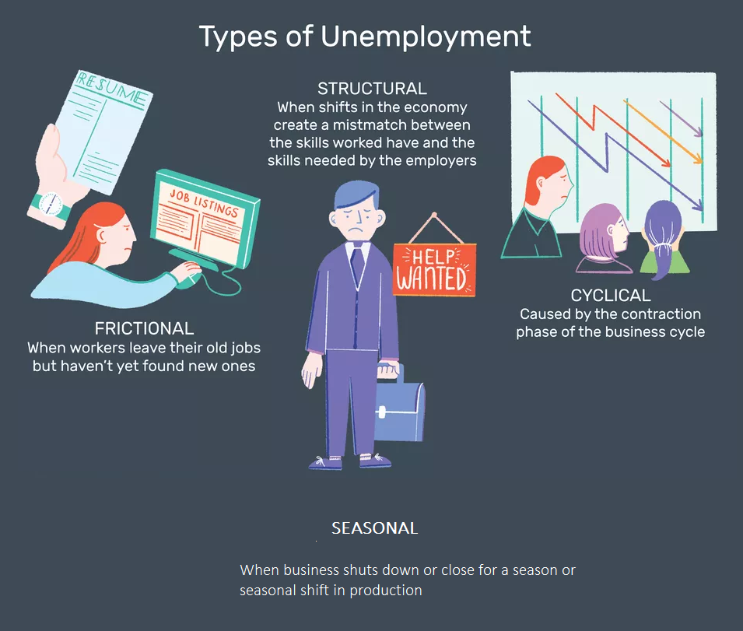
Unemployment
Should firms relocate in areas of higher unemployment?
Though unemployment represents a pool of under-utilised resource and lower wage demand, human resource is one of the factors of production. The availability of skills required by the business, access to transport and supply chain network, infrastructure costs are other factors that influence a firm’s decision to locate to an area. Therefore, higher unemployment in an area alone is not factor that can influence a firm’s decision to relocate.

Slide 21
Questions

